Slide 1
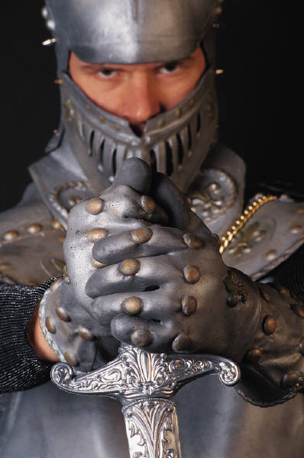
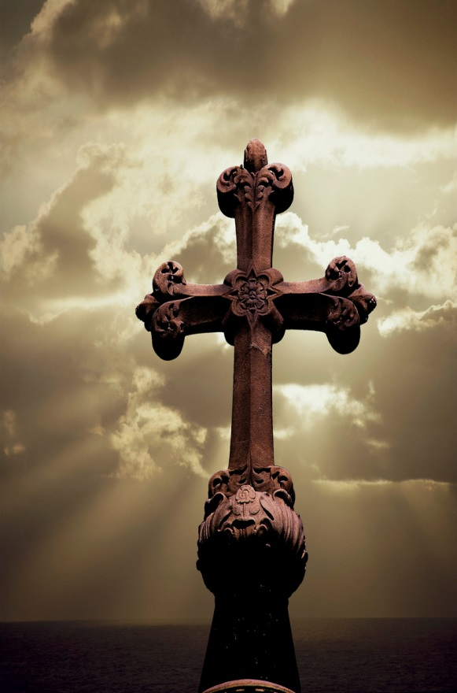
Fight to the death! Love to the death!
2 Timothy 4:5-8

Slide 2
2 Tim 4:5-8
⁵ But you, be sober in all things, endure hardship, do the work of an evangelist, fulfill your ministry.
⁶ For I am already being poured out as a drink offering, and the time of my departure has come.
⁷ I have fought the good fight, I have finished the course, I have kept the faith;
⁸ in the future there is laid up for me the crown of righteousness, which the Lord, the righteous Judge, will award to me on that day; and not only to me, but also to all who have loved His appearing.

Slide 3
“The Reluctant Geometry Student” and “Playing at being Jesus”. C.S.Lewis

Slide 4
The duty of Timothy in trying times.
"⁵ But you, be sober in all things."
" endure hardship.“
" do the work of an evangelist.“
" fulfill your ministry."

Slide 5
The apostle’s death was near.
“⁶ For I am already being poured out as a drink offering, and the time of my departure has come."
.“⁷ I have fought the good fight, I have finished the course, I have kept the faith."
"⁸ in the future there is laid up for me the crown of righteousness, which the Lord, the righteous Judge, will award to me on that day; and not only to me, but also to all who have loved His appearing "

Slide 6
Are you ready to fight to the death, to love until death takes you?
The struggling geometry student… You can’t love what you don’t know and understand.
For love to be perfect we must know Him perfectly and when we do we will perfectly know how much He loves us and when we do we cannot do anything but love Him in return.
The children playing at being grown up… act like you are Jesus Christ and you will become more like Him.

Slide 7
With the love of God on our side who or what is their left to fear? Fight to the death! Love to the death!

